Slide 1

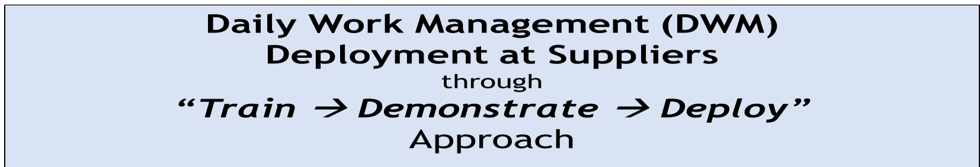
– DWM for Suppliers for FY 24-25
Supplier Name Supplier Code Location
:
:
:
EMDET E01612
Faridabad
Update on : 14.10.2024

Slide 2

Daily Work Management (DWM) FY 2024 – 25
Under Guidance of Mr. Parag Auty . Head TQM , TATA MOTORS
Supplier Name : M/s Emdet
Team . M/s Emdet
Mr. Anil Gupta. Coordinator –President Mr. Neeraj Sharma -Plant Head
Mr. -Quality Head -Nilesh Kumar Mr. Amitesh Kumar Joy Thomas –SCM Head Mr. Ajay Kr Jha - Prod. Manager Mr. Rajeev Chauhan -Technical Head.
Team . M/s TML
Mr. Mangesh Kulkarni . Head
Mr. Pavnesh Sharma . Central TQM
Mr. Pradeep Sangwan . Coordinator
Mr. Anil Vats . Coordinator Mr. Deepak Kumar . SQE
c
Copyright, Confidential, Tata Motors Limited

Slide 3
Dominant Factor:
Rubber : Molding Parameters controlled through PLC. Extrusion : Extrusion Parameters controlled through SIKORA & fixed Die & Nozzle.
Vulcanizers : Parameters controlled through SCADA system .
Compound : Mixing & Testing Equipment.
c
Copyright, Confidential, Tata Motors Limited

Slide 4
a) Type of Organization: Private Ltd.
Industry Segment: MSME
Year of Incorporation: 1978
Top three Customers with products :
Sr. No. | Name of Customer | Products | Location | % Share in Total Turnover
1 | Tata Motors | Automotive Rubber Parts | Pantnagar & Others | 55 %
2 | Ashok Leyland | Automotive Rubber Parts | Pantnagar & Others | 30%
3 | Escorts Kubota | Automotive Rubber Parts | Faridabad | 15%
e) Manpower resource details:
Sr. No. | Manpower |  | No of people as Permanent | No of people as Temporary / on contract
1 | Skilled Manpower |  | 35 | 75 (Level.3)
2 | Unskilled Manpower |  | 0 | 15(Level.1)
c Copyright, Confidential, Tata Motors Limited

Slide 5

Organization Chart Details
Ranjot Singh (MD)
Anil Kumar Gupta (President)
Neeraj Sharma
(Plant Head )
Human Resource Laxman
Commercial & Finance Deelip Kumar
Dispatch /SCM Manish
Quality Assurance Nilesh Kumar
Product Development Soumitro
Manufacturing Rohit
Rubber Compounding &Lab
S Mishra
Maintenance
Sudhir Kumar
Human Resource Ranjeet
Ram Sakal
1-Gaurav 2- Ranveer
In-Process inspection
Dilpreet Singh
Amritesh
1 Shubham Tyagi
Laxmi Narayan
Joy Thomas (SCM Head )
Pre Dispatch Inspection
1- Ayan
Vikash (Mixing )
Bablu Kumar (Lab )
Moulding
Sudhir
Silicon/ Extrusion
Ajay Jha
Fire Wall Inspection Akash Singh
⁻Naveen Sharma
Vishal
Supervisor
Bhart
Keshav
© Copyright, Confidential, Tata Motors Limited

Slide 6

MP & CP Defined at Plant Level
Sr.No. | Managing Points | Control Points | Responsibility
1 | In house PPM | Daily Red bin meeting for Control Rejection | Ajay Jha /Rohit / Nilesh Kumar/ Naveen / vishal (Production/Q.A )
2 | Customer PPM | Fire wall & TPI (CS-2 Level) | Ayan (Quality)
3 | Supplier PPM | Supplier Audit & Performance Monitoring | Akash Singh. (Incoming Quality)
4 | Customer PRR | Product & Process Audit | Shubham Tyagi (Quality)
5 | Delivery | Maintain FG stock & Safety Stock | Ranbir (SCM)
6 | Plan vs Actual Production | Daily Plan vs. Actual Review | Neeraj Sharma (Production & PPC)
7 | Reduce Machine Breakdown | Machine Daily Check sheet & Preventive Maintenance | Sudhir Pathak (Maintenance)
8 | Reduce Machine MTTR | Maintain Stock of critical spare parts | Dilip Kumar (Store )
9 | Increase Machine MTBF | Machine Daily Check sheet & Preventive Maintenance | Sudhir Pathak Maintenance)
10 | Reduce Tool Breakdown | Tool daily Check sheet & Preventive Maintenance | Laxmi Narayan Maintenance)
11 | Reduce Tool MTTR | Maintain Stock of critical spare parts | Sudhir Pathak Maintenance)
12 | Increase Tool MTBF | Tool daily Check sheet & Preventive Maintenance | Sudhir Pathak Maintenance)
13 | Inventory | Min & Max inventory Review | Dilip Kumar (Purchase)
14 | Manpower | Pre planning of Manpower | Laxman (Human Resource)
15 | Absentissem | Motivation Scheme | Laxman (Human Resource)
© Copyright, Confidential, Tata Motors Limited

Slide 7
KPI Monitoring 2024-25
Emdet |  | OBJECTIVE REVIEW MONITORING SHEET
Dept. | Sr. No | Objective | Target 2024-25 | 2024-25
 |  |  |  | Apr'24 | May'24 | Jun.'24 | jul'24 | Aug'24 | Sep'24 | Oct'24 | Nov '24 | Dec'24 | Jan'25 | Feb'25 | Mar'25
Production | 1 | OEE | 85% | 81.33 | 81.48 | 80.81 | 79.78 | 80.57 | 80.57
 | 2 | Machine utilization (in % ) | 85% | 82 | 82 | 81 | 80 | 81 | 81
Maint | 3 | To achieve preventive maintenance Plan | 100% | 90 | 100% | 100% | 100% | 100% | 100%
 | 4 | M/c B/D | 96 Hrs/ Month | 3.91 | 11.83 | 2.41 | 10.46 | 14.60 | 29.43
 | 5 | MTTR | 1.2 Hrs. | 0.78 | 1.69 | 0.60 | 0.60 | 1.12 | 2.45
 | 6 | MTBF | 500 Hrs | 2453.62 | 1751.45 | 3067.40 | 817.44 | 942.88 | 1020.21
© Copyright, Confidential, Tata Motors Limited

Slide 8

KPI Monitoring 2024-25
Emdet |  | OBJECTIVE REVIEW MONITORING SHEET
Dept. | Sr. No | Objective | Target 2024-25 | 2024-25
 |  |  |  | Apr'24 | May'24 | Jun.'24 | Jul'24 | Aug'24 | Sep'24 | Oct'24 | Nov '24 | Dec'24 | Jan'25 | Feb'2 5 | Mar'25
QUALITY | 7 | To reduce customer complaint(Tata Motors ) | 0 | 1 | 1 | 0 | 0 | 1 | 0
 | 8 | Customer PPM (Tata Motors) | 50 PPM /Month | 0 | 0 | 0 | 0 | 0 | 0
 | 9 | CAPA initial Response time (Initial Response within 48 hrs.) | No's of PRR closed>48 Hrs. | 0 | 0 | 0 | 0 | 0 | 0
 | 10 | CAPA Final Response time (Final response within 15 Days) | No's of PRR closed>15 Days | 0 | 0 | 0 | 0 | 0 | 0
 | 11 | Internal Rej. PPM | 18000 PPM /Month | 22540 | 36941 | 49918 | 65610 | 36617 | 33024
 | 12 | Supplier Rej PPM | 80 PPM /Month | 0 | 0 | 0 | 0 | 0 | 0
 | 13 | To achieve layout inspection Plan | 100% | 90 | 90 | 95 | 90 | 100 | 100
 | 14 | COPQ | 1% | 2.40 | 4 | 6.34 | 6.53 | 4.54 | 5.23
 | 15 | Internal Audit | 1/Year as per plan | 1 | 1 | 1 | 1 | 0 | 0
 | 16 | PPAP Submission | Zero pending | 0 | 0 | 0 | 0 | 0 | 0

Slide 9
KPI Monitoring 2024-25
Emdet |  | OBJECTIVE REVIEW MONITORING SHEET
Dept. | Sr. No | Objective | Target 2024-25 | 2024-25
 |  |  |  | Apr'24 | May'24 | Jun.'24 | Jul'24 | Aug'24 | Sep'24 | Oct'24 | Nov '24 | Dec'24 | Jan'25 | Feb'25 | Mar'25
MKT. | 16 | Delivery performance | 100% | 100 | 100 | 100 | 100 | 100 | 100
 | 17 | New Customer | 1/Year | 0 | 0 | 0 | 0 | 0 | 0
 | 18 | To achieve the sales target (Cr.) | 5Cr/Month | 1.88 | 2.81 | 3.07 | 2.62 | 2.34 | 1.95
Eng.& Devp | 20 | On time tool Development | As per Plan | 4 | 9 | 4 | 5 | 10 | 10
 | 21 | To Get new development samples converted into business | 5/year | 4 | 4 | 5 | 20 | 6 | 33
Purchase | 22 | Shortage against Plan | 0 | 0 | 0 | 0 | 0 | 0 | 0
HR | 23 | To Conduct Training As Per plan | 2 Hrs per man / Month | 02 | 02 | 02 | 02 | 02 | 02
 | 24 | To Maintain Accident Status | 0 Level | 0 | 0 | 0 | 0 | 0 | 0
 | 25 | Suggestion | 15 Month | 0 | 0 | 0 | 0 | 0 | 0
 | 26 | Employee Absenteeism | 2% / Month | 9 | 10 | 8 | 8 | 7.98 | 7.90
© Copyright, Confidential, Tata Motors Limited
9

Slide 10
MP & CP to Cascading - Plant Head
Top Management
Managing Point | Target | Controlling Point
Customer Schedule Adherence | 100% as per schedule | Production establishment as per Customer. (TML, ). Daily stock review Store & FG
Increase Plant Turn over | 50 (Rs. Crores) | New customer added Share of Business increase with existing customer by improve customer rating.
Increase Productivity | Plan vs. actual as per target | Continues improvement activity's Plan vs. Actual gap Review Improvement activity through KAIZEN. Top breakdown analysis
Customer Satisfaction | 100% | 100% defect free part deliver to customer. Quick response Improve customer rating.
Reduce Customer Complaint | 0 Complaint | Controlling In house PPM by top defect analysis. Effective quality circle against each complaint.
Working Capital Management
a) RM Inventory | 5 Days | Daily Min & Max stock review Periodic Review on non moving parts. Periodic Review on slow moving parts.
b) WIP | 2 day
c) FG Inventory | 1 Days
© Copyright, Confidential, Tata Motors Limited

Slide 11
MP & CP Defined/ Cascading-Quality Head
Quality
Managing Point | Initial Target | Revised Current Target on 1st Apr 2024 | Controlling Point
Customer line rejection PPM | 50 | 40 | PFMEA review & RPN reduction Q Circle Customer line PPM Monitoring & corrective action against rejection
Overall In house PPM | 20000 | 18000 | Daily PPM monitoring Daily top rejection analysis & action plan Conduct training against defects Red bin meeting
Customer Complaint | 0 | 0 | Q Circle Close the complaint with in target date Review PFMEA & control plan against potential failure Daily review customer feedback
Internal Quality Audit | 1/Year | 1 /Year | Plan audit & Identify Non conformity Review the NC closure
NCs in External audit | 2 | 1 | Conduct process & Product audit & Review the closure Conduct internal audit
NCs in Customer Audits | 0 | 0 | Review 4 M change validation Review the previous NC closure
© Copyright, Confidential, Tata Motors Limited

Slide 12
MP & CP Defined/ Cascading- Production Head
Production Head
Managing Point | Initial Target | Current Revised Target on 1st Apr 2024 | Controlling Point
Dispatch schedule adherence | 100% | 100% | Production as per Customer plan
OEE | 85% | 90% | Improve Productivity through SMED Projects Breakdown analysis & corrective action against NC
Monitoring daily 4 m changes | 100% | 100% | 4 M Change validation
Customer Line (Final PDI) PPM | 200 | 100 | PPM Monitoring & corrective action against rejection Root Cause analysis against problem Daily red bin meeting regarding top defects.
In Process PPM | 20000 | 18000 | Daily PPM monitoring Daily top rejection analysis & action plan Conduct training against defects Red bin meeting
© Copyright, Confidential, Tata Motors Limited

Slide 13
Targets / KPI for DWM :
PPM at TML - a. Current ( Sep 24): 0
PPM at TML(Qty.) a. Current (Sep’ 24):0
COPQ - a. Current (Sep ' 24): 5.23 %
On Time Delivery = a. Current (Sep ' 24): 100 %
Problem resolution PRR a. Sep ' 24): 0
In-Process Rej./Rework in Quantity % -(Sep ' 24): 3.57%
In-Process Rej. / Rework in PPM - ( ' 24): 33024
Warranty-IPTV/EPV( Aug' 24):0
Supplier’s End of Line Fall out – In-house PPM / First Shot Ok / DRR -Nil
b. PPM Target :0
b. PPM Target:0
b. COPQ Target :1%
b. Delivery Target :100%
b. PRR Target :0
b. Target :2% of Production
b. Target :18000
b. Target :0
10. Communication to TATA Motors on 4–M Changes- Adherence 100 % -100%
© Copyright, Confidential, Tata Motors Limited

Slide 14

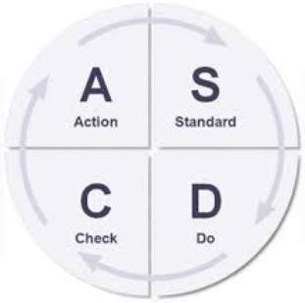
Resolution of Issues by DWM
Top Contributor parts from Defect wise/Part wise Pareto
Problem in Part 1 & So on
Root Cause Analysis
Action on Root Cause
Standardize the changes in SOP/ PFMEA/ Control Plan etc.
Monitoring on Tracker
© Copyright, Confidential, Tata Motors Limited

Slide 15
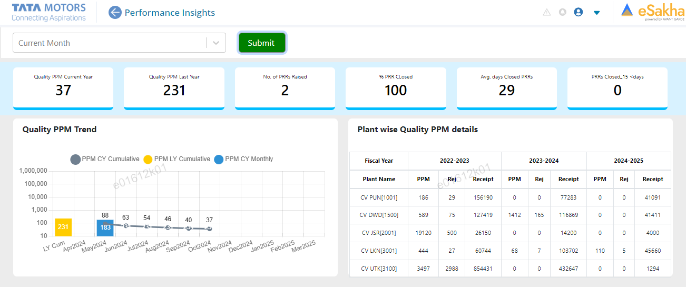
(Target - 50)
PPM at TML :
© Copyright, Confidential, Tata Motors Limited

Slide 16

PPM at TML : (Target - 50)
PPM at TML- Day wise-Sep 24
1
0.5
PPM
0 0 0 0 0 0 0 0 0 0 0 0 0 0 0 0 0 0 0 0 0 0 0 0 0 0 0 0 0 0 0
Day 1 Day 2 Day 3 Day 4 Day 5 Day 6 Day 7 Day 8 Day 9 Day 10 Day 11 Day 12 Day 13 Day 14 Day 15 Day 16 Day 17 Day 18 Day 19 Day 20 Day 21 Day 22 Day 23 Day 24 Day 25 Day 26 Day 27 Day 28 Day 28 Day 29 Day 30
Days
0
PPM at TML – Week wise
1
0
PPM
0 | 0 | 0 | 0
WEEK-1 | WEEK-2 | WEEK-3 | WEEK-4
Months
PPM at TML – Month wise
1
0.5
0
PPM
0 | 0 | 0 | 0 | 0 | 0
Apr-24 | May-24 | Jun-24 | Jul-24 | Aug-24 | Sep-24 | Oct-24 | Nov-24 | Dec-24 | Jan-25 | Feb-25 | Mar-25
Months

Slide 17
PPM data - Pareto of PPM parts at TATA Motors :
S. No. | Part Name Part No. | Problem Description | Immediate Containment | Root Cause | ICA | PCA | Date | Status R/Y/G | Sustenance Monitoring
ZERO PPM IN Sep 2024
© Copyright, Confidential, Tata Motors Limited

Slide 18
PPM In-house. Overall: ( Target < 18000 )
Date Wise PPM
300000
250000
200000
150000
100000
50000
0
254885
97904
39963
₂₄₄₂₂ 36049
41828 42602 ⁴⁹¹²³
31576
48448
44543
33006
56205
₁₂₂₉₂ ₁₈₂₀₇ 28059
44068
32732
42925
33856 ₂₅₆₅₀
49937
4445
1611 0
0
0
15130
0
0
1
2
3
4
5
6
7
8
9
10
11
12
13
14
15
16
17
18
19
20
21
22
23
24
25
26
27
28
29
30
31
PPM / Fallout at End of Line – Week wise
32397 33391
60000
40000
20000
0
32743
47476
PPM
Week-1 Week-2 Week-3 Week-4
week
PPM / Fallout at End of Line - Month wise
₄₉₉₁₈ 65610
36617
70000
36941
60000
22540
PPM
50000
40000
30000
20000
10000
0
Apr-24 May-24 Jun-24 Jul-24 Aug-24 Sep-24 Oct-24 Nov-24 Dec-24 Jan-25 Feb-25 Mar-25
Months

Slide 19

In-house. Pareto chart
Top 5 Defects
6000
100.00%
100.00%
90.82%
90.00%
5000
79.13%
80.00%
66.85%
70.00%
4000
60.00%
3000
2732
50.00%
.38%
44
40.00%
2000
30.00%
1383
756
720
20.00%
1000
565
10.00%
0
0.00%
AIR
LOOSE BONDING
CRACK
Rej. Qty
SHORT MOULD
SURFACE DAMAGE
Cumm %
© Copyright, Confidential, Tata Motors Limited

Slide 20

Action Plan Summary
ACTION PLAN
S. No. | Part Name. | Problem Descriptio n | Date | Immediate Containment Action | Root Cause |  | Action Plan | Target Date | STATUS | Sustenanc e Monitoring
 | Part No.
 |  |  |  |  |  |  |  |  | R/Y/G
1 | KTE11241512 | AIR | 10-09-24 | 100% Segregation to be done. | 1:Sticking Compound material problem. 2.Mould was not clean due to scaling. |  | 1:Quality Alert to be revised and displayed at final inspection area. 2:Awareness Training given to all concerned person. | 15.09.2024 | G | Yes
2 | 278614605802 | LOOSE BONDING | 12-09-24 | 100% Segregation to be done | 1:Mandrel Was Not Clean. 2:Operator was not aware about this problem. |  | 1. Addition check point started during green hollow cutting process for loose bonding checking . 2. Work instruction updated for proper dip of part in tolvine tank during covering process . | 15-09-24 | G | Yes
3 | 572414605872 | THICKNESS VARIATION | 14-09-24 | Quarantine, segregate of parts done as containment action | 1Set up not done properly. |  | 1.Trainning has to be given. 2. 100%Hollow Inspection Work Started and monitoring it. 3-Thickness will be measure and verified an every no's hollow cutting time. | 16-09-24 | G | Yes
© Copyright, Confidential, Tata Motors Limited

Slide 21

Monitoring On-Time Delivery
Target On-Time Delivery 100%
On-Time Delivery at TML- Month wise
100 100
100
100
100
100
100
90
80
70
On-Time Delivery
60
On Time Delivery Company Level as well as Part Level
50
40
30
20
10
0
Apr-24
May-24
Jun-24
Jul-24
Aug-24
Sep-24
Oct-24
Nov-24
Dec-24
Jan-25
Feb-25
Mar-25
Months

Slide 22

Monitoring 4-M Changes
4-M Changes (Total)
2.5
2
1.5
1
0.5
0
2
Total Changes in 4-M Plot & Communicate changes for 4-M
Nos.
1
0
0
0
0
Apr-24 May-24
Jun-24 Jul-24 Aug-24
Sep-24 Oct-24 Nov-24
Months
Dec-24
Jan-25
Feb-25
Mar-25
Man Changes
Machine Changes
1
Material Changes
Method /Tier -2 Supplier Changes
2.5
2
1.5
1
0.5
0
1
0.8
0.6
0.4
0.2
0
2
0.8
1
0.8
0.6
0.4
0.2
0
1
0.6
Nos.
Nos.
0.4
Nos.
Nos.
0
0
0
0
0.2
0 0 0 0 0
0
0 0 0 0 0
0
0 0 0 0 0
0
0
Apr-24
May-24 Jun-24 Jul-24 Aug-24 Sep-24 Oct-24 Nov-24 Dec-24 Jan-25 Feb-25 Mar-25
Apr-24
May-24 Jun-24 Jul-24 Aug-24 Sep-24 Oct-24 Nov-24 Dec-24 Jan-25 Feb-25 Mar-25
Apr-24
May-24
Jun-24 Jul-24 Aug-24 Sep-24 Oct-24 Nov-24 Dec-24 Jan-25 Feb-25 Mar-25
Apr-24
May-24 Jun-24 Jul-24 Aug-24 Sep-24 Oct-24 Nov-24 Dec-24 Jan-25 Feb-25 Mar-25
Months
Months
Months
Months

Slide 23
Monitoring 4M Changes
4M Change Control Management Sheet
Change Type | Change | N o’s of Change manpower | Change Details (Incase of Change) | Supplier Name | Change summary | Reason for Change | Month
 | (Yes / No)
 |  |  |  |  |  | No change | Sep ’24
© Copyright, Confidential, Tata Motors Limited

Slide 24
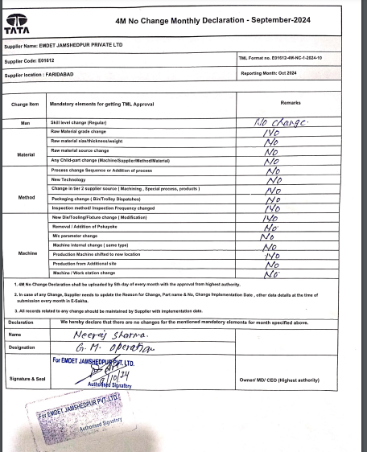
4M Declaration Sheet Signed-off by Quality Head & Plant Head
© Copyright, Confidential, Tata Motors Limited

Slide 25
COPQ Graph Month wise
COPQ % Against Sale
COPQ as percentage of sales
COPQ includes Reject, rework, repair & including expense visit to
Customer
10.00%
9.00%
8.00%
7.00%
6.34%
6.53%
6.53%
5.23%
Target COPQ = 1.0%
6.00%
5.00%
4.54%
4.00%
4.00%
3.00%
2.40%
2.00%
1.00%
0.00%
SEP'24
COPQ
APR'24
MAY'24
JUN'24
JUL'24
AUG'24
OCT'24
NOV'24
DEC'24
JAN'25
FEB'25
MAR'25
© Copyright, Confidential, Tata Motors Limited
26

Slide 26













2nd Level COPQ Analysis-PIE Chart (Reason for Rejection) In-Process/Set up approval: (Target <18000 PPM)
Material , 720
Man & Environment
Method , 756
In-House PPM/COPQ
Reduction
WIP
Method
Material
Machine ,
1383
Man , 3295
Machine
Man Machine Method Material
© Copyright, Confidential, Tata Motors Limited

Slide 27
Major Contributed part in COPQ : Action Plan
Sr. No. | Part Name | Problem | Rejection Qty. | Why-Why | Action Plan | Month | Status
1 | KTE11241512 | AIR |  | Why 1- Sticking Compound material problem. 2.Mould was not clean due to scaling. | .Quality Alert to be revised and displayed at final inspection area. 2:Awareness Training given to all concerned person. | Sep 24 | Closed
2 | 278614605802 | LOOSE BONDING |  | Why-1 Loose bonding . Why 2- Addition was not good Why 3- Rubber Melt not properly. Why 4 –Tolvene dipped not properly. Why 5- Curing set up not adequate. | Training has to be given. 2.Green hollow kept smoothly. 3.100% Hollow Surface Inspection Work Start and monitoring it. 4. Hollow use after 4 hrs. from produce time.
 | 278614605802 | LOOSE BONDING |  |  |  |  | Closed
3 | 278614605802 | Thickness Variation |  | Why 1- Thickness Variation observed 3.80mm to 5.30mm against . Why 2- Thickness variation found in every coil layer Why 3 – Uniform Thickness was not available. Why- 4- set up not done properly. | Training has to be given. 2. Thickness to be maintained on mean to max side 5.0±0.5mm. 3.100% Hollow Inspection Work Start and monitoring it. 4.Thickness Will be Measure And verified and every no's hollow Cutting Time.
 |  |  |  |  |  |  | Closed
©

Slide 28
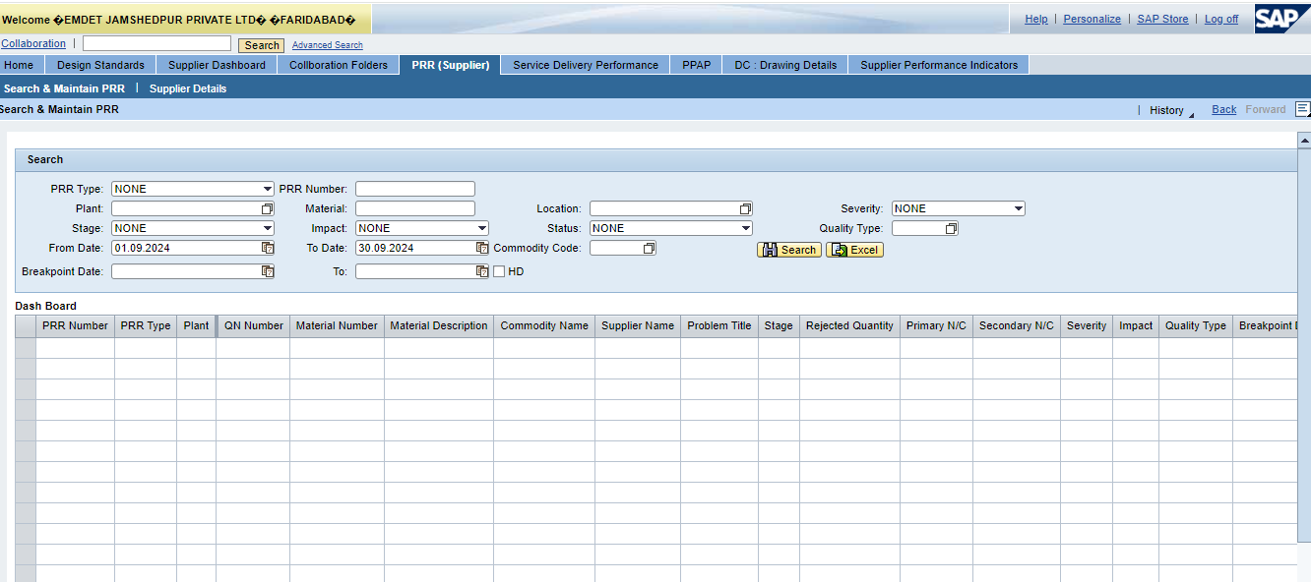
Monitoring PRR Monthly & Daily
at TML
PRR
Problem Resolution Report(PRR)at TML– Month wise
4
PRR
2
1
1
0
May-24
0
Jun-24
0
Jul-24
0
0
Apr-24
Aug-24
Sep-24
Months
Oct-24
Nov-24
Dec-24
Jan-25
Feb-25
Mar-25
© Copyright, Confidential, Tata Motors Limited

Slide 29
PRR Action plan :2024-25
No Customer Complaint In September 2024
© Copyright, Confidential, Tata Motors Limited

Slide 30
Horizontal Deployment & Effectiveness monitoring
 | Sr No. | Problem Reported | Action Taken | Action Resolved | Applicable part numbers |  |  |  | Responsibility | Planned date | Status | Effectiveness monitoring
 |  |  |  |  | 573550105805 | 573550105806 | 573550105807 | 573550105808 |  |  |  | Apr | may | Jun | Jul | Aug | Sep | Oct | Nov | Dec | Jan | Feb | Mar
1 |  | MIXUP ISSUE | Started Using coverd & sealed BINS for such parts | 20.05.2022 | Y | Y | Y | Y | Neeraj Sharma | 20.05.2022 | Completed | 0 | 0 | 0 | 0 | 0
2 |  | 11 DIA ONE HOLE MISSING | Implemented permanent fixture to remove the hole dia. | 28.05.2022 | - | - | - | - | Neeraj Sharma | 28.05.2022 | Completed | 0 | 0 | 0 | 0 | 0
3 |  | THICKNESS 2.9 TO 4.1 FOUND UPTO 2.62 | Inhouse Specification Of Green Hallow Was Changed & taken at Upper Spec. Side | 27.05.2022 | - | - | - | - | Neeraj Sharma | 27.05.2022 | Completed | 0 | 0 | 0 | 0 | 0
4 |  | MTG HOLE MISMATCH AS PROFILE REVERSE | Profile Fixture is implimented, now 100% part is checked with fixture. | 24-11-23 | - | - | - | - | Neeraj Sharma | 24-11-23 | Completed | 0 | 0 | 0 | 0 | 0
5 |  | RADIATOR END NOTCH CUT MISSING | 100% notching checking with paint marker before packing. | 16-02-23 | - | - | - | - | Neeraj Sharma | 16-02-23 | Completed | 0 | 0 | 0 | 0 | 0
6 |  | HOSE,RESERVOIR TO TMC PRIMARY | 1 Thickness gauge has been implemented for 100% inspection of thickness variation. | 16-02-23 | - | - | - | - | Neeraj Sharma | 16-02-23 | Completed | 0 | 0 | 0 | 0 | 0
7 |  | HOSE,AUX WATER TANK TO BYPASS TUBE | 1 Mandrel has been polished. 2 lux level has been increased on the final inspection table. | 16-02-23 | - | - | - | - | Neeraj Sharma | 16-02-23 | Completed | 0 | 0 | 0 | 0 | 0
8 |  | HOSE,RADIATOR INTAKE | 1- Knitting pitch size has been Increased from 7±1 to 8±1 pitch/inch. | 24-01-23 | Y | Y | Y | Y | Neeraj Sharma | 24-01-23 | Completed | 0 | 0 | 0 | 0 | 0
9 |  | COOLANT LEAKAGE DUE TO PARTING LINE | Focus hand light also implemented to check from the hose inside | 31-03.23 | x | x | x | x | Neeraj Sharma | 31-03.23 | Completed | 0 | 0 | 0 | 0 | 0
10 |  | PROFILE NOT OK AND WRONG PART NUMBER PRINT | 100% parts will check in final inspection area with final profile fixture | 31-03.23 | - | - | - | - | Neeraj Sharma | 31-03.23 | Completed | 0 | 0 | 0 | 0 | 0
11 |  | THICKNESS FOUND 4.12MM AGAINST OF 3 TO 4 (Wall thickness found variation ) | 100% parts checking started at final inspection area with thickness gauge at 4 points | 26-03-24 | - | - | - | - | Aas Mohd. | 26-03.23 | Completed | 0 | 0 | 0 | 0 | 0

Slide 31

Track L1/L2/L3 Status & Migration Plan
Level of controls
L1
L2
L3
Remarks
41
18
14
09
 | Jul’ 24
Total |  | L1 | L2 | L3
40 |  | 18 | 13 | 09
Aug’24
Sep’24
Total | L1 | L2 | L3
40 | 18 | 13 | 09
Total | L1 | L2 | L3
40 | 18 | 13 | 09

Slide 32

Process Robustness- Enhanced & Sustainable Controls
Improve
Sustain
L1-L2-L3
Sustenance Audit
(What is fixed MUST remain fixed)
40
35
30
L1 L2 L3
96%
95%
94%
93%
92%
91%
90%
89%
88%
87%
95% 95% 95% 95% 95%
25
20
18
14
18
18
18
18
18
15
10
13
9
13
9
13
9
13
9
1
90%
13
9
9
5
0
Apr'24 May'24 Jun'24 Jul'24 Aug’24 Sep 24
L1 L2 L3
Apr'24May'24Jun'24 Jul'24 Aug’24 Sep24
% compliance

Slide 33
DWM Activities Vs. Benefits
DWM Activities
Achievements & Benefits
Training provided for MP & CP to supervisor and line inspector.
MP & CP define department wise for all.
DWM Daily monitoring board display for all departments to review and tracking MP & CP.
4 M Monitoring started & Board display for monitoring.
Kaizen implemented for reducing machine breakdown.
Surface damage / Mandrel touch free & top rejection part projects taken for reduce internal PPM & COPQ %.
Daily Action review department wise to target met.
Customer PPM,Customer PRR,Supplier PPM,In house
PPM,Daily Machine /tool break down etc.
To be Reduced the COPQ %- & COPQ Cost-(Rs.)
Reduced Customer PPM from 50 to 0 .
Reduce Maintenance breakdown through kaizens
Productivity Increase (OEE)
Cost saving through Improvements Yearly.
Team Work Improved
Sustain Customer Complaint, Delivery Adherence
Increase Machine Capacity through Kaizen.
Vendor Code | Supplier Name | Year 2023- 24 | PPM TGT | Apr24 | May24 | Jun24 | Jul24 | Aug24 | Sep24 | Oct24 | Nov24 | Dec24 | Jan25 | Feb 25 | Mar 25
E01612 | Emdet | 231 | 50 | 0 | 0 | 0 | 0 | 0 | 0
© Copyright, Confidential, Tata Motors Limited

Slide 34








Glide Path PPM Reduction Plan-2024-25
4000
3500
3000
2500
2000
1500
1000
500
0
1. Bar code system to be implement in chemical auto weighing machine
3497
2325
PPM
Q-1
Q-2
Q-3
Q-4
504
231
₀ 50
Bench Mark
Target
Act.

Slide 35
Thank You
© Copyright, Confidential, Tata Motors Limited

